Slide 1
HAPPIEST HEALTH · REIMAGINING & REFORMING HEALTHCARE IN INDIA SUMMIT 2026 · DIGITAL TWIN CHALLENGE
AarogyaTwin
T2D
Predict. Prevent. Personalise. — a digital twin for 90-day glycaemic deterioration
Team AarogyaTwin (DTU)
Sarthak · Shoury · Abhay
Delhi Technological University · DTU-IIF · BBA 2025
What you will see in 8 minutes
live twin dashboard → twin mechanics → validation numbers →
what-if counselling → India scale-up plan & our ask
0.974
5.49
400 × 90
4
AUROC, 90-day deterioration (GroupKFold-5 OOF)
mg/dL next-day forecast MAE (−18% vs persistence)
synthetic patients × days, 18.8% event prevalence
counterfactual lifestyle scenarios per patient
Phase-1 Prototype & Code Submission · public GitHub repo · MIT licence · synthetic data only
Notes:
30-second opener: name the challenge, the condition we twinned and the single sentence value proposition. Then jump straight to the one-pager.

Slide 2
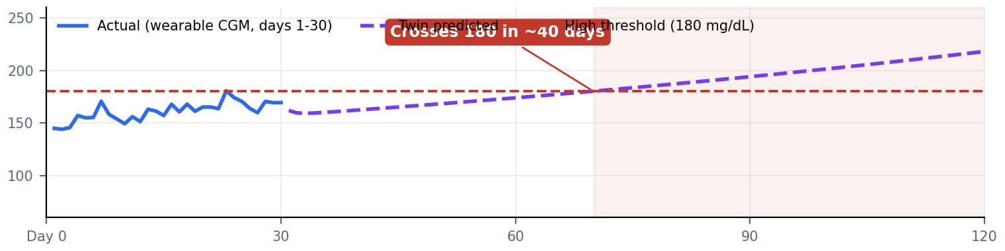
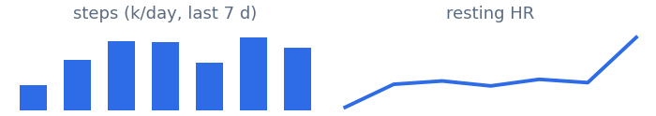
🫀
AarogyaTwin
T2D
An AI-powered digital twin that predicts whether a patient's glucose will cross the high threshold within 90 days - using EHR history plus daily wearable streams (CGM, steps, sleep, heart rate) - and simulates which lifestyle change prevents it.
⏰
Early Warning
weeks before the next HbA1c
🎯
Personalised
what-if simulation per patient
Your Digital Twin for Smarter Glucose Decisions · Predict. Prevent. Personalise.
🛡
Open & Safe
MIT · synthetic · zero PHI
Patient Dashboard
Real-time insights from your digital twin (30 days assimilated)
Phase-1 PoC · day 30 of 90
🫀 AarogyaTwin
India · T2D twin
Dashboard
💧
Current Glucose (day 30)
↑
Predicted (day 61-90 mean)
⏱
Time to Threshold
🎯
90-d Deterioration Risk
Patient Profile
169
206
~40
97
Elevated
mg/dL
High Risk
mg/dL
twin forecast
days
%
target 70-140
>140 = high
day 70
HIGH
model prob.
Predictions
Glucose Forecast (next 90 days)
⚠ Risk Alert
Glucose Trends
Twin predicts mean glucose crosses 180 mg/dL around day 70 (40 days from now) if nothing changes.
Activity & Lifestyle
Recommended actions (simulated):
Settings
🚶
+3,500 steps/day → eA1c 8.5% (-0.3 pp)
💧
Adherence +30% → eA1c 8.3% (-0.5 pp)
📋
Combined plan → eA1c 8.1%, TIR 76%
🩺
Care-team review within 14 days
Patient ID: GT-129
Type 2 Diabetes (synthetic)
Recent Glucose Readings
Activity & Lifestyle
Patient Profile
Day 30
169 mg/dL
5912 steps
Age 38 · Female · BMI 32.2 · Urban
Family hx T2D: Yes · HbA1c 6.4%
Adherence 7% · SBP 136 mmHg
Day 29
169 mg/dL
6850 steps
Day 28
170 mg/dL
4484 steps
⬢ System Architecture
🗄 Datasets & Data Sources (open / synthetic)
★ Key Features & Tech Stack
EHR + Wearables
Twin Engine
ML risk + forecast
Dashboard & alerts
1. Synthetic EHR - 400 patients, Indian epidemiology
2. Wearable streams - 36,000 patient-days (CGM/steps/sleep/HR)
3. Twin states, 4 scenario roll-outs & CV metrics per patient
✓ 90-day early warning, not quarterly hindsight
✓ What-if lifestyle simulation (steps / diet / adherence)
✓ CV-validated: AUROC 0.974 · forecast MAE 5.5 mg/dL
✓ No PHI · fully synthetic · MIT-licensed · DPDP-ready
Py
NP
sk
St
pt
✓
reproducible in ~20 s
Notes:
Open here: this single slide IS the product. Walk the jury left-to-right: brand promise, live twin dashboard for one real synthetic patient, then the engineering evidence band at the bottom. Every number on it is computed by the repo pipeline - nothing is mocked.

Slide 3
🫀
The Problem
& The Gap
Care happens ~4 times a year via HbA1c snapshots, while deterioration unfolds invisibly between visits. Wearables already stream the missing signal - but raw streams are neither predictions nor personalisation.
📈
101 M
Indians with diabetes
⚠
~50 %
undiagnosed until complications
India's diabetes care is reactive and blind between visits
🩺
4 / yr
clinical touchpoints only
101 M
136 M
~50 %
4×/yr
Indians living with diabetes - world's largest burden (IDF / ICMR-INDIAB)
with prediabetes - the twin's prevention market
undiagnosed; complications found after irreversible damage
HbA1c snapshots - physiology moves daily, care moves quarterly
Three structural gaps we attack
1 · Latency - deterioration is discovered a quarter too late, at the next HbA1c.
2 · Blindness - between visits nobody sees glucose, steps, sleep or stress move.
3 · Generic advice - 'walk more' is not a plan; patients ask what happens to MY sugar if I change MY habits.
Our challenge answer
Twin ONE localised, high-burden outcome: predict 90-day glycaemic deterioration in Type 2 Diabetes 30 days ahead - and simulate which single lifestyle change prevents it.
Outcome definition (label)
90-day glycaemic deterioration =
• mean CGM rise ≥ 25 mg/dL (days 61-90 vs 1-30), OR
• mean CGM ≥ 180 mg/dL (sustained hyperglycaemia)
Prevalence in cohort: 18.8%
Features may only use data up to day 30 - the twin must warn before the event window even starts.
Notes:
Frame the pain in 45 seconds: burden numbers, then the structural gap (sparse reactive care), then our one-sentence challenge answer.

Slide 4
🫀
How The
Twin Works
A discrete state-space replica x = [insulin sensitivity, progression rate, glucose]: initialised from the EHR, corrected daily by wearables, then rolled forward under any lifestyle scenario.
🧬
Born from EHR
static record seeds the state
📡
Updated daily
Kalman-gain fusion of CGM day
Birth → Assimilation → Simulation, every single day
🔮
Simulates futures
counterfactual 90-day roll-outs
1 · BIRTH
2 · ASSIMILATE
3 · SIMULATE
x₀ = f(EHR)
x ← x + K(z − h(x))
roll 90 days
SI, progression & glucose initialised from BMI, age, adherence, family history
each wearable day: predict CGM from state, correct state by the innovation
what-if scenarios → eA1c, time-in-range, time-to-threshold, risk band
Live example - patient GT-129 (risk 97%)
Why this is a twin, not a model
• It has a persistent per-patient state that evolves with data - not a one-shot score.
• It can be interrogated: 'what if +3,500 steps?' answers in milliseconds.
• Its latent states (SI, progression) become ML features - the twin teaches the classifier.
• 150 lines of NumPy = fully inspectable by clinicians & jury.
Notes:
The mechanics slide. Emphasise the three defining properties of a digital twin and that the engine is 150 lines of inspectable NumPy - a feature, not a limitation.

Slide 5
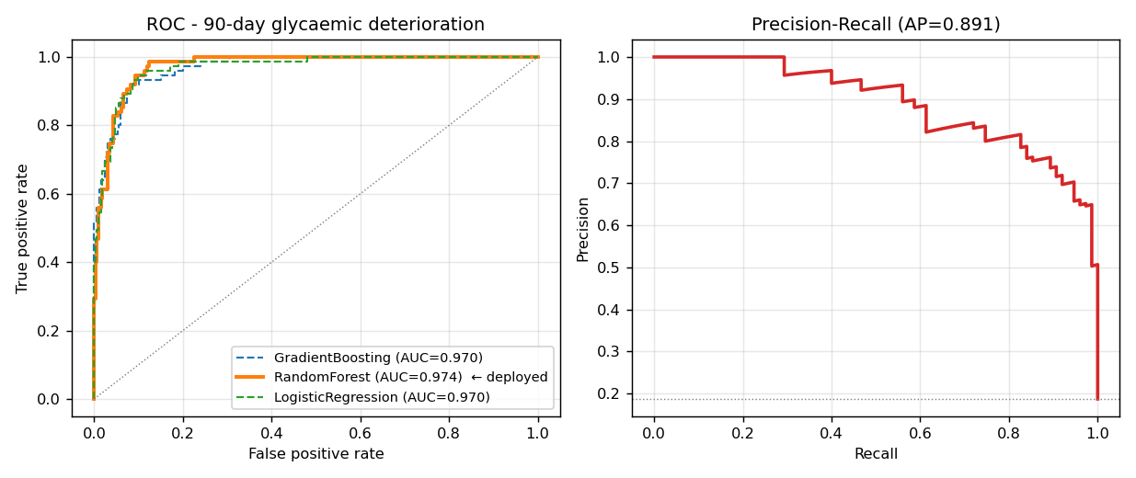
🫀
Models &
Validation
Model A: 90-day deterioration risk from 19 features (10 EHR + 6 wearable-30d + 3 twin latent states). Model B: next-day glucose head. GroupKFold(5) by patient; winner refit and shipped.
🧪
GroupKFold(5)
out-of-fold, by patient
🏆
Zoo benchmark
GBDT vs RF vs LogReg
An honest CV benchmark - the winner gets deployed
🧬
Twin-augmented
latent states as features
0.974
0.891
5.49
0.055
AUROC - deployed RandomForest (zoo: 0.970, 0.974, 0.970)
Average Precision at 18.8% prevalence - the curve that matters for screening
mg/dL next-day MAE vs 6.71 persistence (−18%)
Brier score - probabilities are calibrated, not just ranked
Top twin-augmented risk drivers
hr_mean_d30
0.31
twin_prog_d30
0.16
twin_ea1c_d90
0.10
glucose_mean_d30
0.08
family_hx_t2d
0.06
med_diet_adherence
0.05
twin_si_d30
0.04
bmi_kg_m2
0.04
teal = twin-derived latent features · blue = EHR/wearable raw features
Notes:
Numbers slide. Say the zoo + CV protocol first (rigour), then the two headline metrics, then the twin-augmentation point: latent states as features.

Slide 6
🫀
What-If
Counselling
For every patient the twin rolls four 90-day futures: status quo, +3,500 steps/day, adherence +30% (diet + meds), and the combined plan. Counselling becomes a choice between simulated futures.
🔀
4 scenarios
per patient, per visit
📉
eA1c & TIR
clinically familiar read-outs
Simulate the intervention before you prescribe it
💬
One sentence
the patient actually understands
Simulated 90-day futures - patient GT-129
The sentence that wins the jury
“If nothing changes, your sugar average crosses 180 around day 70. If we add 3,500 steps and tighten your diet & meds adherence by 30%, your forecast HbA1c falls from 8.8% to 8.1% and you stay in range 76% of days.”
Personalised, simulated, and honest about uncertainty - the difference between a risk score and a digital twin.
Scenario | eA1c day-90 | TIR % | vs status quo
Status quo | 8.8% | 43% | +0.0 pp
+3,500 steps/day | 8.5% | 54% | -0.3 pp
Adherence +30% | 8.3% | 63% | -0.5 pp
Combined plan | 8.1% | 76% | -0.7 pp
TIR = forecast fraction of days with mean glucose 70-180 mg/dL · eA1c = (mean G + 46.7)/28.7
0.7 pp
33 pp
<1 s
0
eA1c reduction unlocked by the combined plan (this patient)
time-in-range gain - from 90 simulated days
to simulate all four scenarios on a laptop
extra devices needed - works with any smartwatch + CGM
Notes:
The counselling story. Read the status-quo row aloud, then the combined plan row - the delta is the clinical value of a digital twin.

Slide 7
🫀
India
Scale-Up
The twin plugs into rails India already builds - ABDM health IDs, NDHM data standards, and a smartwatch/CGM market heading to mass affordability - so the marginal cost per patient is computation, not infrastructure.
🇮
ABDM-ready
FHIR/NDHM data standards
⌚
Device-agnostic
any CGM + smartwatch stream
From PoC to pilot: rails, devices, unit economics
💰
Cheap to run
CPU-only, <1 s per patient
INTEGRATION RAILS
DEVICES & DATA
UNIT ECONOMICS
• ABDM Health ID as patient key; EHR via FHIR/NDHM
• Wearable ingest: CGM + steps + sleep + HR (daily batch)
• Alerts routed to clinic queue & patient app (vernacular)
• Low-cost CGM (~₹2-3k/month) + ₹2k smartwatch
• Fallback: phone-only steps + lab EHR (degraded twin)
• Synthetic→real transfer: recalibrate priors per clinic
• Compute: <₹1 per patient-month (CPU inference)
• Value: one avoided complication ≫ years of twin cost
• Model: B2B2C via incubator hospital + insurer wellness
Proposed Phase-2 pilot (with incubator hospital partner)
• n = 200 T2D patients, 6 months, single arm vs matched standard-care cohort.
• Primary endpoint: lead time of twin alert vs HbA1c-based detection of deterioration.
• Secondary: eA1c change, TIR change, counselling adherence, clinician trust score.
• Pre-registered analysis + fairness slices (age, sex, urban/rural) published with results.
Our ask: shortlist + intro to one pilot site & one CGM partner. We bring the twin, the code and the team.
Notes:
Show the jury this is a business/health-system plan, not a hackathon artefact: integration rails (ABDM), device economics, pilot design with endpoints.

Slide 8
🫀
Ethics, Limits
& Roadmap
Synthetic data validates the pipeline, not clinical efficacy. The twin is decision support for counselling - never a diagnosis, never a device. Privacy is structural: zero PHI ships with the repo.
🔒
Zero PHI
synthetic generator published
⚖
Fairness plan
slices pre-registered
What a PoC can and cannot claim - stated openly
🧭
Support only
clinician stays in loop
Ethics & privacy by design
• No real patient data anywhere in the public repo - the generator is the audit trail.
• MIT licence; every link public, no sign-in, no permissions (submission requirement).
• DPDP Act 2023 alignment: purpose limitation, no PHI, consent-ready architecture.
• Alerts are advisory; clinician confirmation mandatory before any action.
Limitations we own
• Synthetic cohort - effect sizes validate engineering, not efficacy.
• Daily resolution vs 5-min real CGM; simplified Bergman physiology.
• Single outcome; no medication-titration logic yet.
• Fairness slices (age/sex/urban-rural) are roadmap, not results.
Now
+6 mo
+18 mo
+36 mo
Phase-1 PoC
this submission
Phase-2 pilot
200 patients, 1 site
Phase-3
5-min CGM + med titration
Phase-4
prospective RCT vs standard care
Each phase gate publishes metrics + fairness slices before scaling - evidence first, expansion second.
Notes:
Pre-empt the hardest jury questions here: privacy, over-reliance, fairness, and what the PoC cannot claim. Confidence comes from stating limits first.

Slide 9
🫀
Jury Q&A
& Close
Everything is in the public repo: code, tests, metrics, decks, Power BI pack and the unlisted demo video. We are ready for the live demo.
❓
Prepared
6 hardest questions answered
📦
One repo
code → decks → dashboard
The six questions we expect - and our one-line answers
🙏
Thank you
Happiest Health & the jury
Why not just use a risk score?
The twin simulates futures; a score only ranks patients.
Is the data real?
Synthetic by design (no PHI); pipeline validated end-to-end, pilot planned.
Does the ML beat simple baselines?
Yes - and we ship the baselines: logreg & persistence.
Can clinicians trust the twin?
150-line inspectable engine + calibrated probabilities + CV OOF.
What breaks first in reality?
Adherence logging - hence degraded phone-only fallback mode.
Cost to run at national scale?
<₹1/patient-month compute; rails (ABDM) already exist.
Predict the event. Simulate the alternative. Personalise the medicine.
Repo: [GITHUB REPO URL] · Demo video (unlisted): https://youtube.com/watch?v=[YOUTUBE_VIDEO_ID]
Team AarogyaTwin (DTU) - Sarthak · Shoury · Abhay · Delhi Technological University · DTU-IIF
Thank you, Happiest Health & jury - we are ready for the live demo. 🙏
Notes:
Close with the Q&A ammo on screen - it signals preparedness - then the repo, the video and the thank-you. Pause on the ask.

